Slide 1

Operating Systems Design​ Session 25: Manipulation of the Process Address Space
19CS2106R​
© 2020 KL University

Slide 2
Region
The kernel divides the virtual address space of a process into logical regions
A region is a contiguous area of the virtual address space of a process that can be treated as a distinct object to be shared or protected.
Thus text, data, and stack usually form separate regions of a process.
Several processes can share a region.
Several processes may execute the same program, and it is natural that they share one copy of the text region.
Several processes may cooperate to share a common shared-memory region.
The kernel contains a region table and allocates an entry from the table for each active region in the system.
Each process contains a private per process region table, called a pregion for short

Slide 3
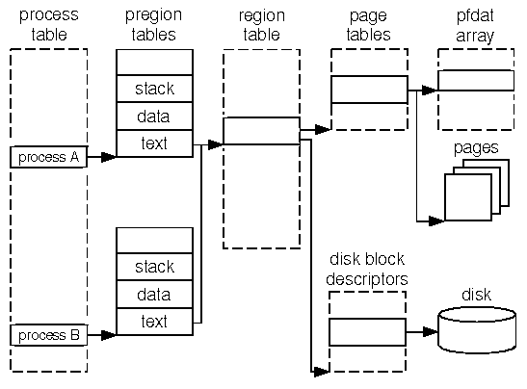

Slide 4
Region Table
The region table entry contains the following information:
The i-node of the file from which the region was initially loaded
The type of the region (text, shared memory, private data, or stack)
The size of the region
The location of the region in physical memory.
The state of the region: locked, in demand, being loaded into memory, valid, loaded into memory
The reference count, giving the number of processes that reference the region

Slide 5
Operations on Regions
The operations that manipulate regions are:
Lock a region
Unlock a region
Allocate a region
Attach a region to the memory space of a process
Change the size of a region
Load a region from a file into the memory space of a process
Free a region
Detach a region from the memory space of a process
Duplicate the contents of a region

Slide 6
Operations – Algorithm Design

Slide 7
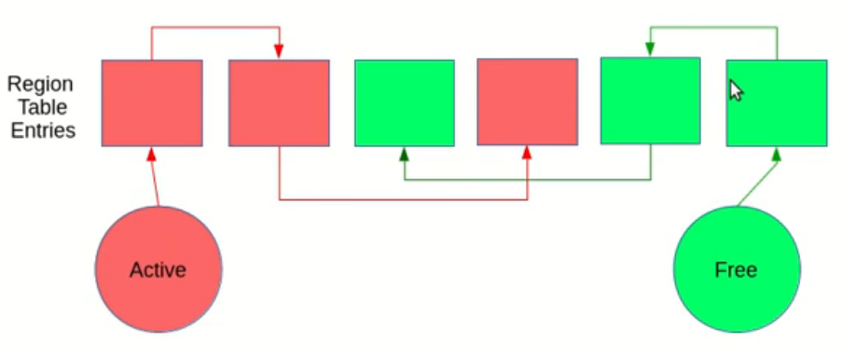
Allocate a region
The kernel allocates a region when fork, exec, and shmget (shared memory get) system calls occurs.
Just like i-nodes, the kernel has a free list of regions.
When a region is to be allocated, the kernel picks up the first region from the free list and puts it on the active list.
The i-node is used by the kernel to enable other processes to share the region.
The kernel increments the i-node reference count to prevent other processes from removing its contents when unlinking it.
We have to make sure if the i-node pointer is not null because there are a few exceptions where a region is not associated with an i-node.

Slide 8
Allocate a region Algorithm
/* Algorithm: allocreg
* Input: inode pointer * region type
* Output: locked region
{
remove region from linked list as a free regions;
assign type of region;
assign inode pointer region;
if (inode pointer not null)
increment inode reference count;
put the region on linked list of active regions;
return (locked region);
}

Slide 9
Attaching a Region to a Process
/* Algorithm: attachreg
* Input: pointer to (locked) region being attached
* process to which the region is being attached
* virtual address in process where region will be attached
* region type
* Output: pre process region table entry
*/
{
allocate per process region table entry for process;
initialize per process region table entry;
set pointer to region being attached;
set type field;
set virtual address field;
check legality of virtual address, region size;
increment region reference count;
increment process size according to attached region;
initialize new hardware register triple for process;
return (per process region table entry);
}
The kernel attaches the region to a process address space by using attachreg system call. It is used in fork, exec, and shmat.
The region being attached may be newly allocated or already allocated region which is to be shared.
Process region table modifications
region table Modifications

Slide 10
/* Algorithm: growreg
* Input: pointer to per process region table entry
* change in size of region (positive or negative)
* Output: none
*/
{
if (region size increasing)
{
check new region size is legal ;
allocate auxiliary tables (page tables);
if (system unable to support demand paging)
{
assign a physical memory;
initialize auxiliary tables, as necessary;
}
}
else // region size decreasing
{
deallocate physical memory, as appropriate;
free auxiliary tables, as appropriate;
}
do (other) initialization of auxiliary tables, as necessary;
set size field in process table;
}
Changing the Size of a Region
The stack region can be changed (it can be expanded or shrunk) automatically when nesting of calls is done.
The data region of a process can be expanded with the sbrk system call.
It also internally calls growreg.
Both of these regions are private to a process.
Shared regions cannot be extended, so there are no side-effects of growreg.

Slide 11
Loading a Region
/* Algorithm: loadreg
* Input: pointer to per process region table entry
* virtual address to load region
* inode pointer of file for loading region
* byte offset in file for start of region
* byte count for amount of data to load
* Output: none
*/
{
expand region size to the max size of region (algorithm: growreg);
mark region state: being loaded into memory;
unlock region;
set up u-area parameters for reading file:
track virtual address where data is read to,
start offset value for reading file,
count of bytes to read from file;
read file into region (internal variant of read algorithm);
lock region;
mark region state: completely loaded into memory;
awaken all processes waiting for region to be loaded;
}
Load File to Region
Demand paging : the kernel can "map" a file into process address space when the exec system call is made.
It then read individual physical pages later if necessary.
No Demand paging: Copy the executable file into memory
No other process is allowed to read region
Read File to Region
Allow the process for reading region

Slide 12
/* Algorithm: freereg
* Input: pointer to a (locked) region
* Output: nothing
*/
{
if (region reference count not a zero)
{
// some process still using region
release region lock;
if (region has an associated inode)
release inode lock;
return;
}
if (region has associated inode)
release inode (algorithm: iput);
free physical memory still associated with region;
free auxiliary tables associated with region;
clear region fields;
place region on region free list;
unlock region;
}
Freeing a Region
When a region is no longer attached to any processes, the kernel can free the region and return it to the list of free regions.

Slide 13
Detaching a Region from a Process
/* Algorithm: detachreg
* Input: pointer to per process region table entry
* Output: nothing
*/
{
get auxiliary memory management tables for process, release as appropriate;
decrement process size;
decrement region reference count;
if (region reference count is 0 and region not stick bit)
free region (algorithm: freereg;)
else // either reference count non-0 or region sticky bit on
{
free inode lock, if applicable (inode associated with region);
free region lock;
}
}
The kernel detaches regions by the exec, exit, and shmdt system calls.
The address translation mechanisms thus invalidated apply specifically to the process, not to the region (as in the algorithm freereg).
The kernel decrements the region reference count.
If the region referenced count drops to 0, the kernel frees the region with algorithm freereg.
Otherwise, it only releases the region and inode locks.

Slide 14
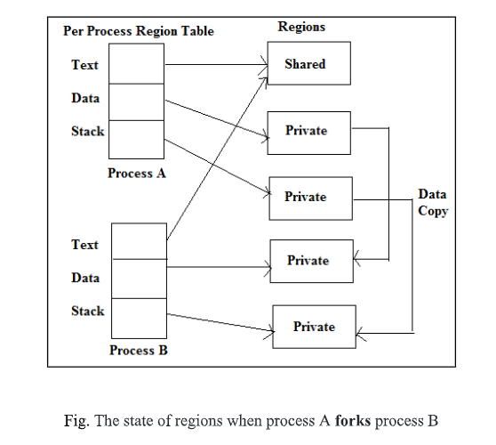
Duplicating a Region
In the fork system call, the kernel requires to duplicate the regions of a process.
If the region is shared, the kernel just increments the reference count of the region.
If it is not shared, the kernel has to physically copy it, so it allocates a new region table entry, page table, and physical memory for the region.

Slide 15
Duplicating a Region
/* Algorithm: duplicate_reg
* Input: pointer to region table entry
* Output: pointer to a region that similar to input region
*/
{
if (region type is shared)
// caller will increment region reference count with attachreg call
return (input region pointer);
allocate new region (through the allocreg);
set up auxiliary memory management structures, as currently exist in input region;
allocate physical memory region contents;
"copy" region contents from input region to newly allocated region;
return (pointer to allocated region);
}

Slide 16
XV6 Implementation

Slide 17
Allocate a region Algorithm in xv6
1924 // Allocate page tables and physical memory to grow process from oldsz to newsz, which need not be page aligned. Returns new size or 0 on error.
1926 int
1927 allocuvm(pde_t *pgdir, uint oldsz, uint newsz)
1928 {
1929 char *mem;
1930 uint a;
1931
1932 if(newsz >= KERNBASE)
1933 return 0;
1934 if(newsz < oldsz)
1935 return oldsz;
1936
1937 a = PGROUNDUP(oldsz);
1938 for(; a < newsz; a += PGSIZE){
1939 mem = kalloc();
1940 if(mem == 0){
1941 cprintf("allocuvm out of memory\n");
1942 deallocuvm(pgdir, newsz, oldsz);
1943 return 0;
1944 }
KERNBASE is the starting address of the kernel's address space (0x80000000 or 2GB in xv6) New size can’t be over 2GB
If it cannot allocate memory

Slide 18
Allocate a region Algorithm in xv6
1945 memset(mem, 0, PGSIZE);
1946 if(mappages(pgdir, (char*)a, PGSIZE, V2P(mem), PTE_W|PTE_U) < 0){
1947 cprintf("allocuvm out of memory (2)\n");
1948 deallocuvm(pgdir, newsz, oldsz);
1949 kfree(mem);
1950 return 0;
1951 }
1952 }
1953 return newsz;
1954 }
Flags the page as writeable
and to be used by programs
(otherwise only the kernel
can access it)
kfree to free physical
memory at run-time

Slide 19
1900 // Load a program segment into pgdir. addr must be page−aligned
1901 // and the pages from addr to addr+sz must already be mapped.
1902 int
1903 loaduvm(pde_t *pgdir, char *addr, struct inode *ip, uint offset, uint sz)
1904 {
1905 uint i, pa, n;
1906 pte_t *pte;
1907
1908 if((uint) addr % PGSIZE != 0)
1909 panic("loaduvm: addr must be page aligned");
1910 for(i = 0; i < sz; i += PGSIZE){
1911 if((pte = walkpgdir(pgdir, addr+i, 0)) == 0)
1912 panic("loaduvm: address should exist");
1913 pa = PTE_ADDR(*pte);
1914 if(sz − i < PGSIZE)
1915 n = sz − i;
1916 else
1917 n = PGSIZE;
1918 if(readi(ip, P2V(pa), offset+i, n) != n)
1919 return −1;
1920 }
1921 return 0;
1922 }
Loading a Region
Get page table entry being loaded
already allocated earlier look up address to load into
Get physical address from page table entry convert back to kernel virtual address for read from disk
Copy from file represented by struct inode into memory P2V(pa) – mapping of physical address in kernel memory

Slide 20
Deallocate a region
1956 // Deallocate user pages to bring the process size from oldsz to newsz. oldsz
// and newsz need not be page−aligned, nor does newsz need to be less than oldsz.
// oldsz can be larger than the actual process size. Returns the new process size.
int
deallocuvm(pde_t *pgdir, uint oldsz, uint newsz)
{
pte_t *pte;
uint a, pa;
if(newsz >= oldsz)
return oldsz;
a = PGROUNDUP(newsz);
Deallocates user pages to bring the process size from oldsz to newsz.
PGROUNDUP is a macros to round the address sent to a multiple of the PGSIZE.

Slide 21
Deallocate a region
Walk page table and get pte
for(; a < oldsz; a += PGSIZE)
{
pte = walkpgdir(pgdir, (char*)a, 0);
if(!pte)
a = PGADDR(PDX(a) + 1, 0, 0) − PGSIZE;
else if((*pte & PTE_P) != 0)
{
pa = PTE_ADDR(*pte);
if(pa == 0)
panic("kfree");
char *v = P2V(pa);
kfree(v);
*pte = 0;
}
}
return newsz;
}
If PGSIZE is not subtracted when going to the next PDE, then a would be off by PGSIZE elements the next iteration.
Deallocate a page
Get physical address from page table entry convert back to kernel virtual address for read from disk
get virtual address of page
free page
mark internal page table entry as "pointing at no page"

Slide 22
duplicating a page table
2044 for(i = 0; i < sz; i += PGSIZE){
2045 if((pte = walkpgdir(pgdir, (void *) i, 0)) == 0)
2046 panic("copyuvm: pte should exist");
2047 if(!(*pte & PTE_P))
2048 panic("copyuvm: page not present");
2049 pa = PTE_ADDR(*pte);
2050 flags = PTE_FLAGS(*pte);
2051 if((mem = kalloc()) == 0)
2052 goto bad;
2053 memmove(mem, (char*)P2V(pa), PGSIZE);
2054 if(mappages(d, (void*)i, PGSIZE, V2P(mem), flags) < 0) {
2055 kfree(mem);
2056 goto bad;
2057 }
2058 }
2059 return d;
2060
2061 bad:
2062 freevm(d);
2063 return 0;
2064 }
Check for the pages
get physical address of parent process's page
2032 // Given a parent process’s page table, create a copy
2033 // of it for a child.
2034 pde_t*
2035 copyuvm(pde_t *pgdir, uint sz)
2036 {
2037 pde_t *d;
2038 pte_t *pte;
2039 uint pa, i, flags;
2040 char *mem;
2041
2042 if((d = setupkvm()) == 0)
2043 return 0;
copy memory from old physical page to new physical page
set up kernel virtual pages

